Slide 2
Introduction to Git and Github
Aman Chopra
Microsoft Learn Student Ambassador

Slide 3
Agenda
Version Control Systems and its types
Why Git?
Basics of Git
Github: An Overview
Collaborate and Contribute using Github
Github for Students

Slide 4
What is Version Control ?
It is a system that records changes to a file or a set of files over time so that you can recall specific versions later.
It allows you to –
Revert the selected files back to a previous state,
Revert the entire project back to a previous state,
Compare changes over time,
See who has modified your code and when
Who introduced an issue and when.

Slide 5
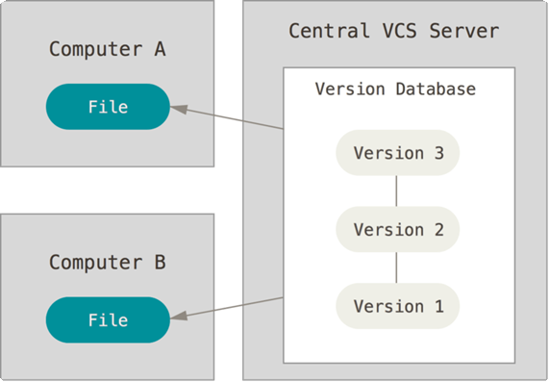
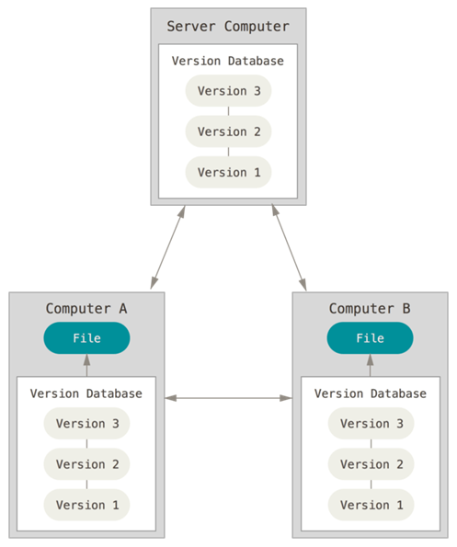
Types of Version Control Systems
Centralized VCS
Distributed VCS

Slide 6
Why Git?
Distributed Version Controlling System
Ease in collaboration
No more tension on loosing of old code
Live code and development code kept in one place
Easy to manage with large codebases
Distributed Development

Slide 7
Basics of Git
Here are some basic git commands one should be familiar with:
git init
git add file_name
git status
git commit -m “Message”
git remote add origin repo_link
git push –u origin master

Slide 8

Github: An Overview of the Platform
Github is one of the most popular platforms for Version Control.
If Git is the ingredient, Github is the final product.
Largest hub of open source software.
We can also create “BRANCHES” here
Github’s Logo – The Octocat

Slide 9
Hands on with git and github

Slide 10
Q & A

Slide 11
Thank You!

